Slide 1

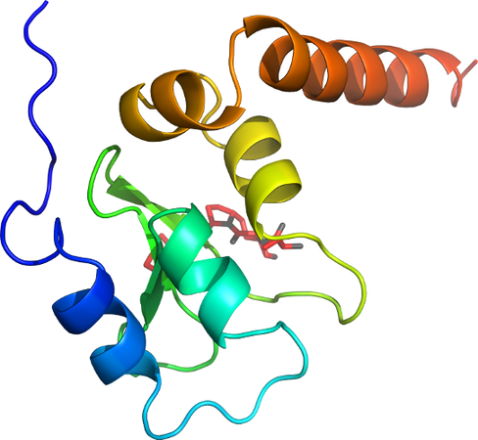

Protein/Small Molecule Docking (Ligand Docking)
Rocco Moretti
Vanderbilt University

Slide 2
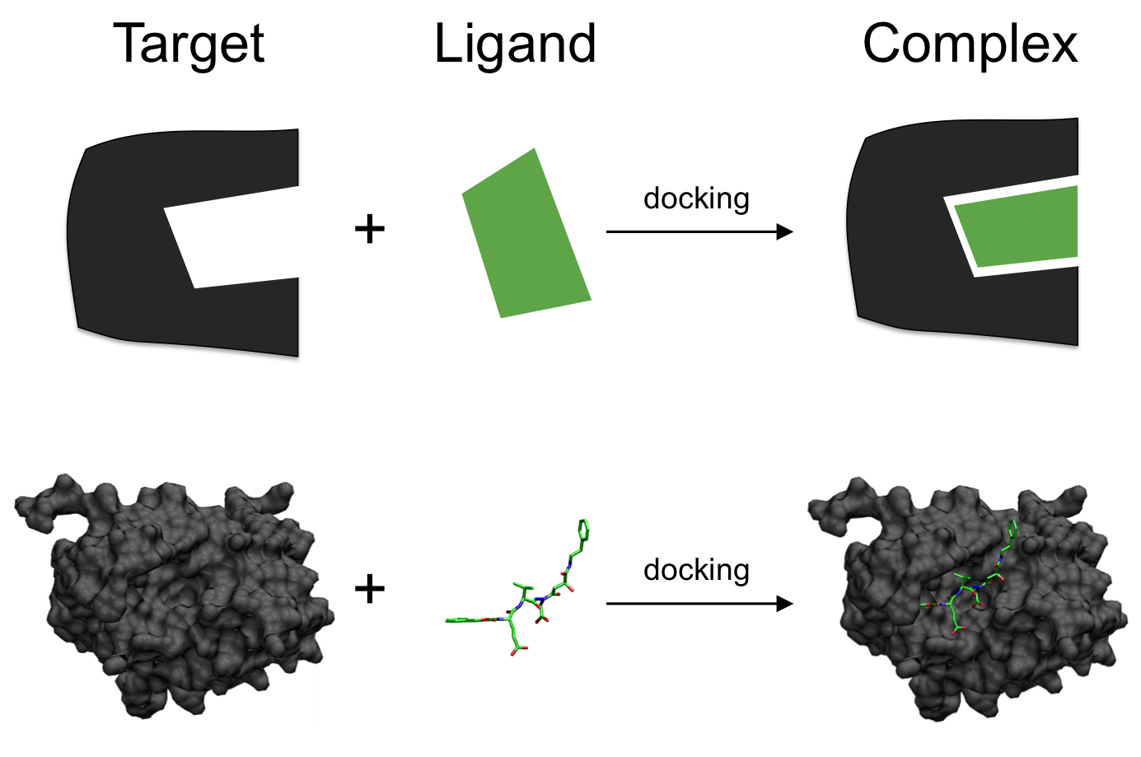
Ligand Docking
Scigenis, via Wikimedia Commons

Slide 3
Ligand Docking
Scigenis, via Wikimedia Commons

Slide 4
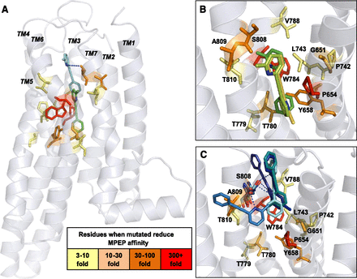
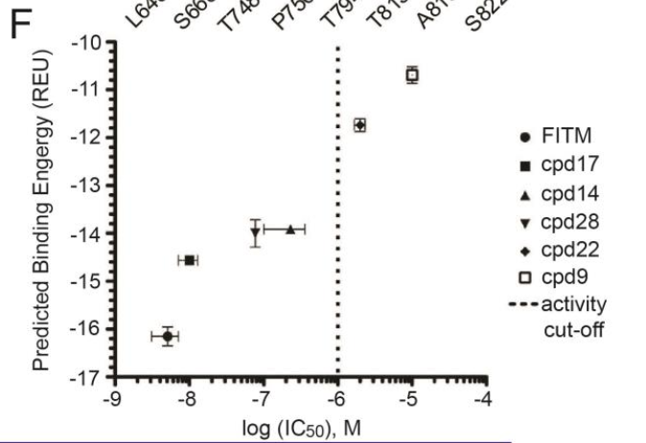
Ligand Docking and Rosetta
H. Wu et al., Science 344(6179):58–64 (2014).
K. J. Gregory et al., Molecular pharmacology 83, 991–1006 (2013).
Notes:
The NAM MPEP docked into the mGlu₅ comparative model. MPEP was docked into the mGlu₅ comparative model in two separate experiments, centered at P654 and S808. (A) The lowest-energy conformation for MPEP from the largest cluster docked at P654 is shown in green and at S808 is shown in cyan. Highlighted are the residues that caused decreases in MPEP affinity when mutated, colored by graded effect compared with wild type. (B) The lowest-energy models from the largest three clusters for MPEP docked at P654. (C) The lowest-energy models from the largest five clusters for MPEP docked at S808. Predicted hydrogen bonds between the nitrogen on the pyridine ring and S808 are depicted by dotted blue lines.

Slide 5
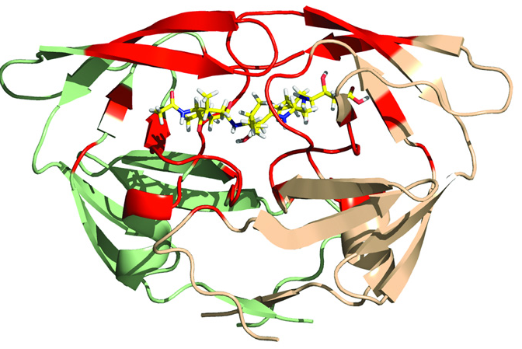
RosettaLigand History
Meiler and Baker 2006
Protein and ligand ensembles
Side chain flexibility
Davis and Baker 2009
Backbone flexibility near binding site
Lemmon and Meiler 2012
XML Scripts
Deluca and Meiler 2015
High throughput screening and improved low resolution sampling
Fu and Meiler 2018
RosettaLigand Ensemble
HIV-1 PR homodimer (green/wheat) with acetylpepstatin (yellow) in binding site (red)
G. Lemmon et. al. Chemical biology & drug design (2012).

Slide 6
When is RosettaLigand likely to work?
Crystal structures (ideally in complex with ligand of similar chemotypes)
Rigid, well-defined binding pocket
Drug-like small molecules capable of making hydrophilic/H-bond interactions
Experimental restraints
Docking (finding binding mode) is much easier than ranking or predicting activity!

Slide 7
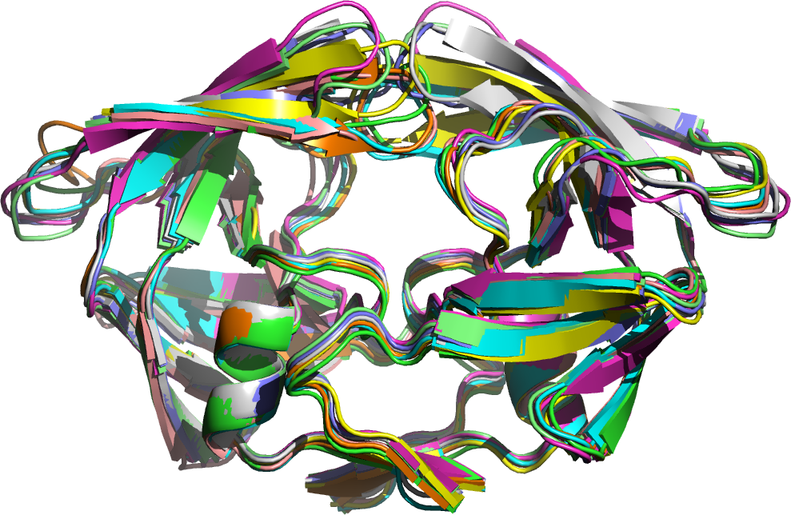
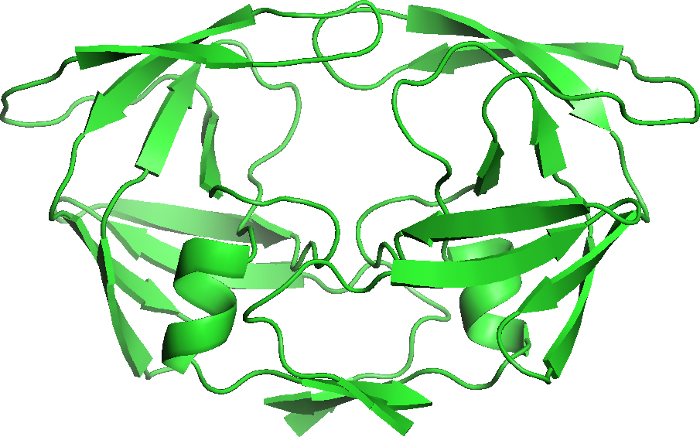
Protein Model Selection
Protein conformation sources:
Crystal structures/NMR
Comparative modeling
Alphafold, Omegafold for de-novo structure prediction
Better to run dock into multiple models

Slide 8
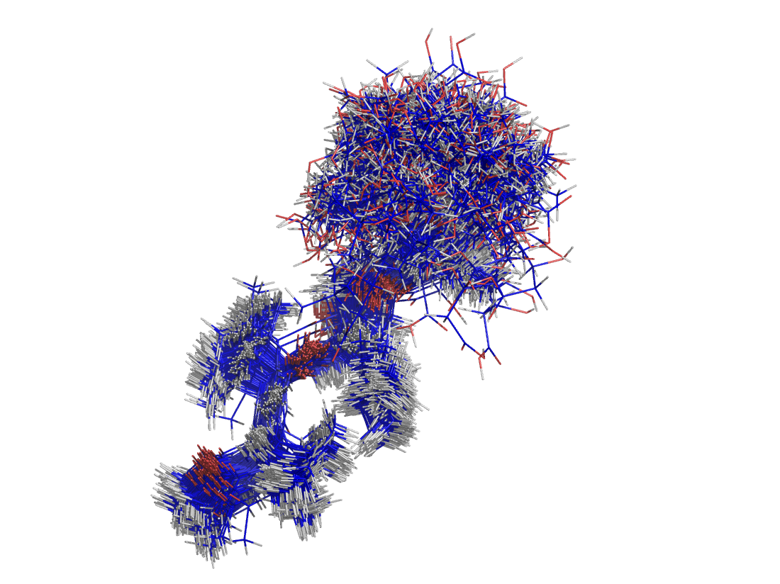
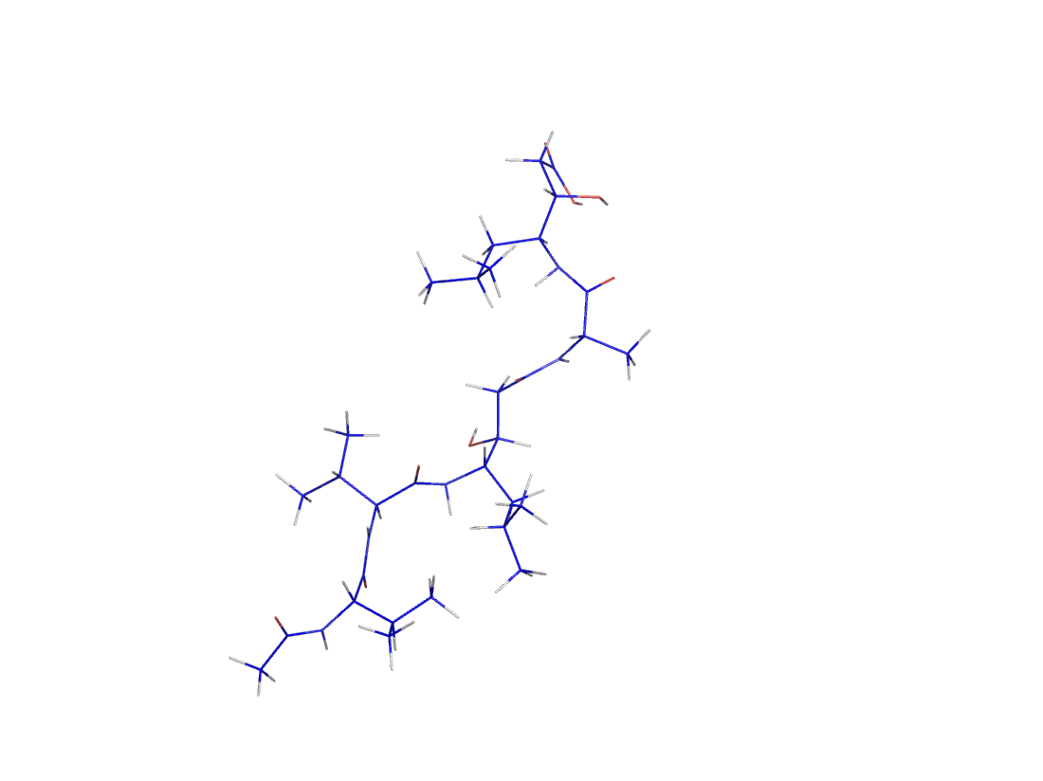
Ligand Conformer Generation
Ligand conformation sources:
BioChemicalLibrary (BCL) https://github.com/BCLCommons/bcl
Commercial software: MOE/OpenEye
FROG2 Server http://bioserv.rpbs.univ-paris-diderot.fr/services/Frog2/

Slide 9
RosettaLigand Overview
Low Resolution
Coarse Grained
High Resolution
Atomistic
Initial Placement
Small ligand moves
Monte Carlo
accept/reject
Interface side-chain moves
Gradient based minimization
Transform
Final minimization

Slide 10
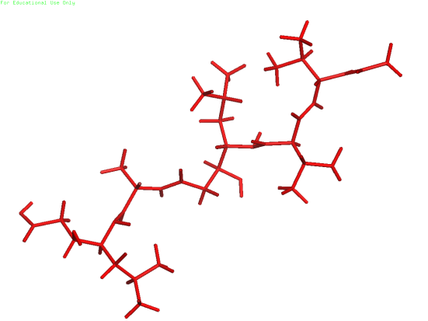
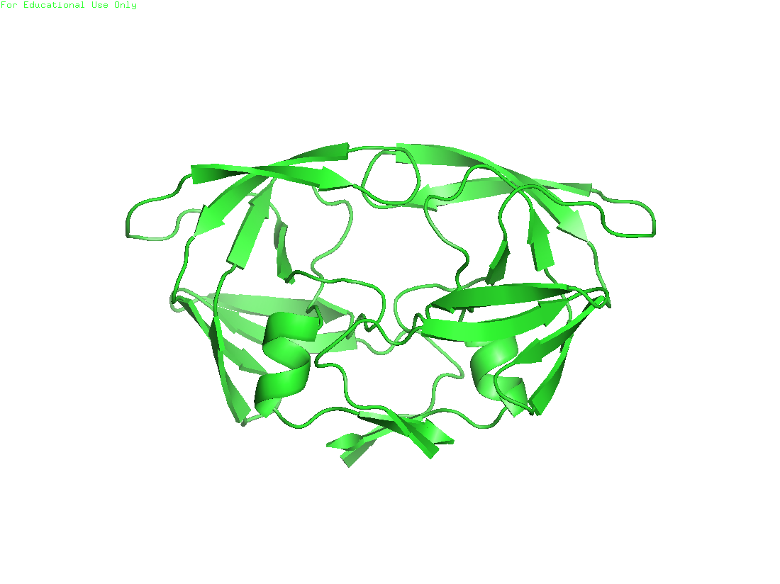
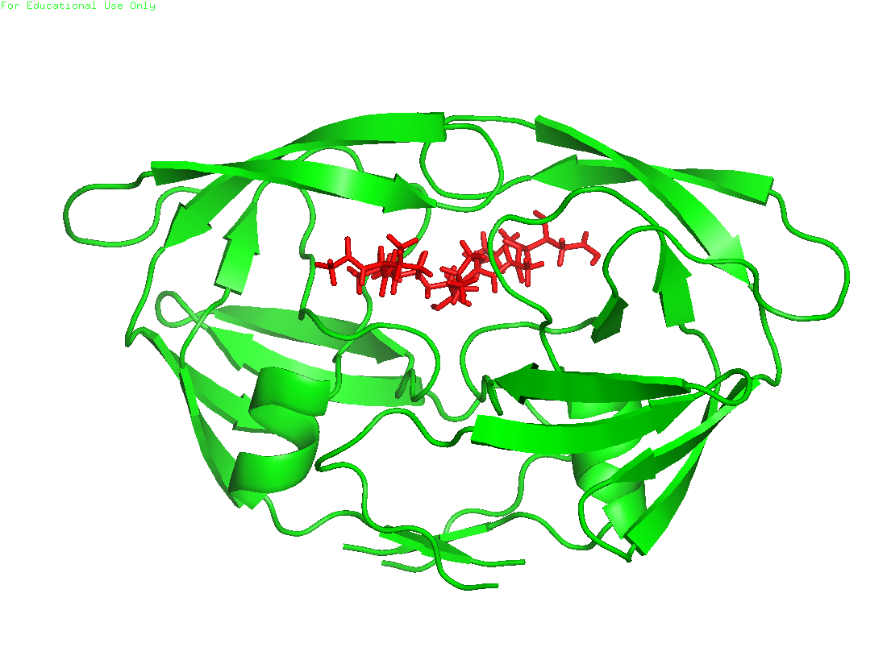
RosettaLigand Algorithm
Initial placement
Transform
Docking Cycles
High res refinement

Slide 11
Transform Algorithm
Start
Random Conformer Change
Random Translation + Rotation
Flip a Coin
Did the Score in the Grid Improve?
Yes, Keep Move
No, Monte Carlo

Slide 12
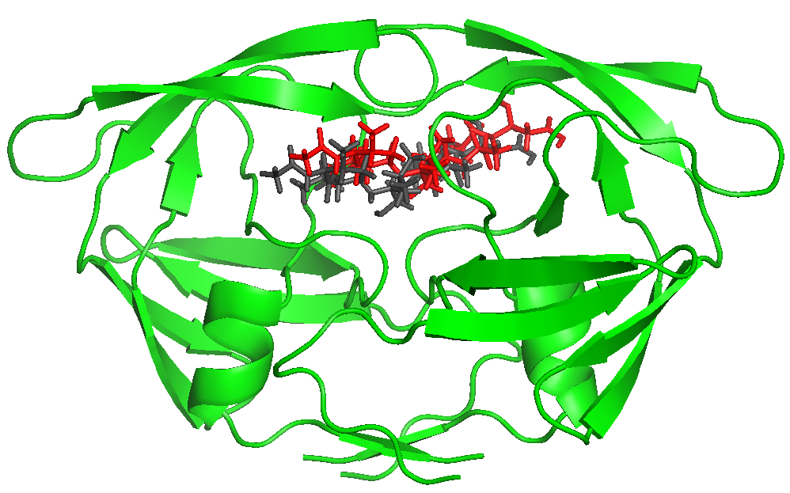
RosettaLigand Algorithm
Initial placement
Grid based Monte-Carlo Translation, Rotation, and Conformation Sampling
Transform
Docking Cycles
High res refinement

Slide 13
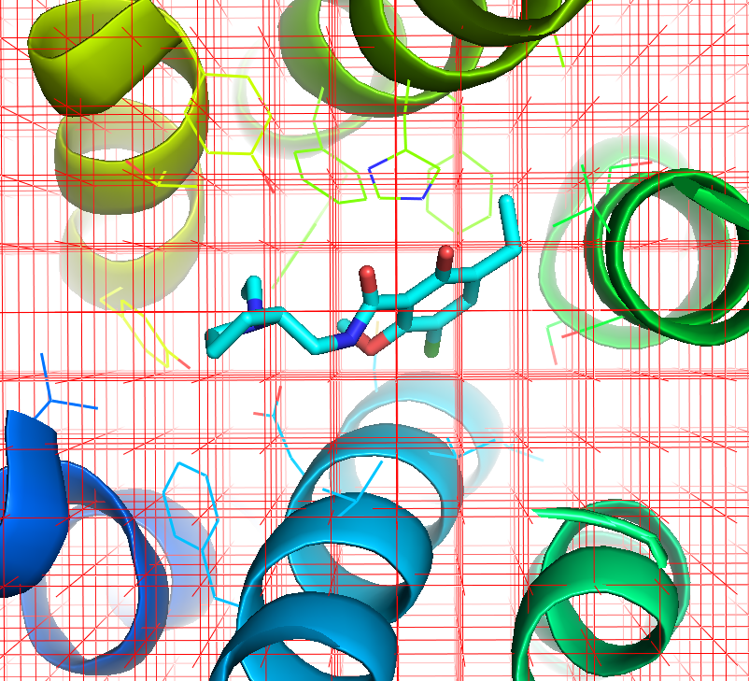
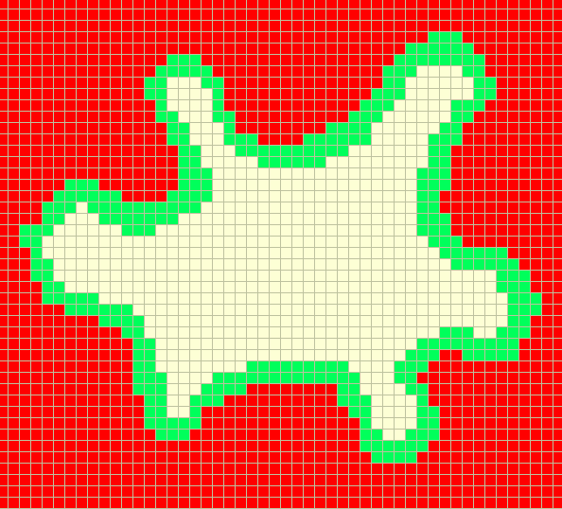
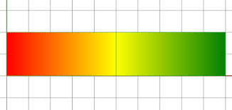
Transformation Grid
Calculates score at each point in grid
Determines where the ligand can move
This only based on sterics
Repulsive Attractive
+1 0 -1

Slide 14
RosettaLigand Algorithm
Initial placement
Move Ligand
Transform
Rotamer Trials
Full Repack
Docking Cycles
Gradient-based Minimization (side chain, ligand)
High res refinement
Accept/Reject

Slide 15
RosettaLigand Algorithm
Initial placement
Gradient Based Minimization of side-chain and backbone torsion angles
Transform
Docking Cycles
High res refinement

Slide 16
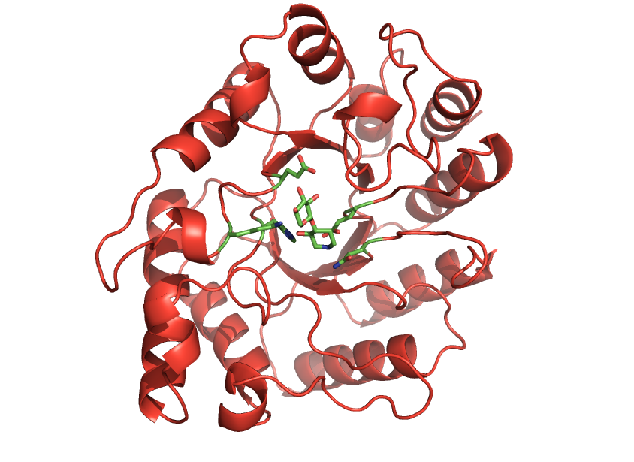
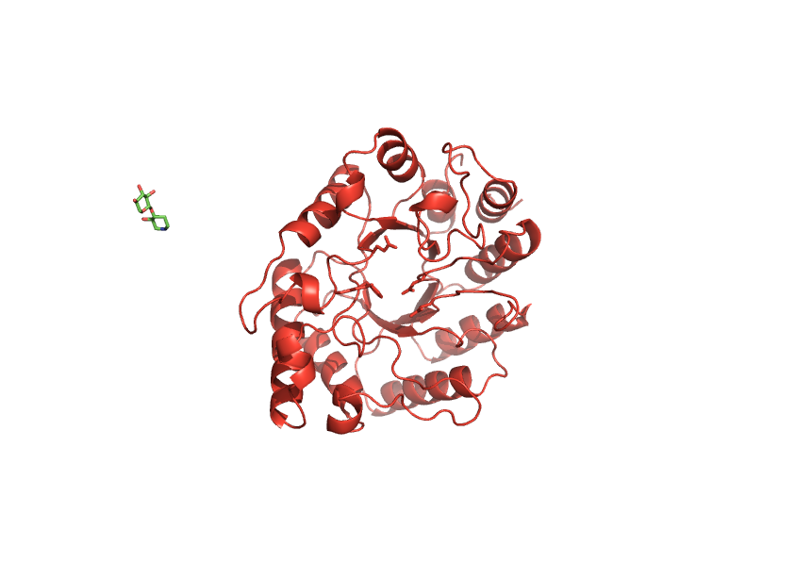
Scoring
interface_delta_X = Score(Bound) - Score(Unbound)
(Note: sidechains do NOT repack here)

Slide 17
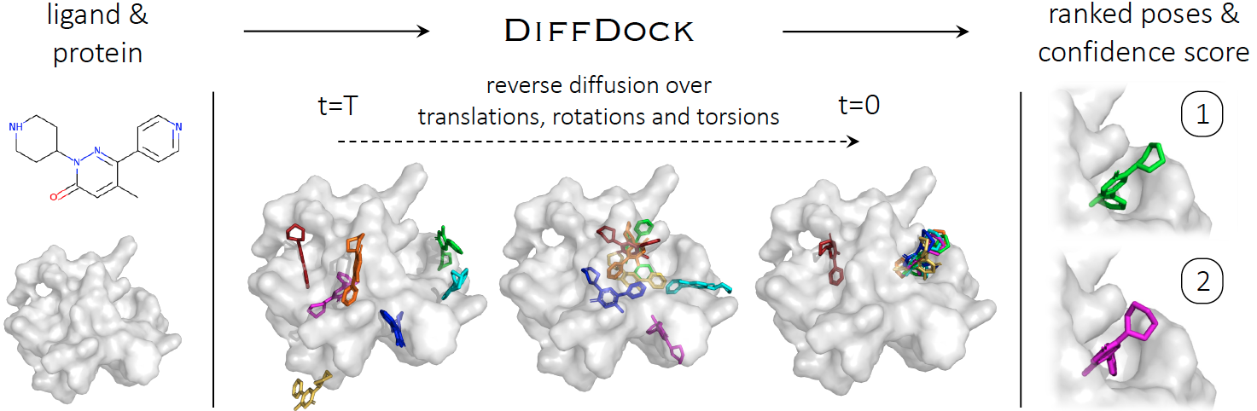
Of course, enter AI

Slide 18

Generating Molecules?
De Novo Ligand Generation
DiffSBDD (https://www.nature.com/articles/s43588-024-00737-x -- Published: 09 December 2024)
Ultra Large Library
RosettaVS (https://doi.org/10.1038/s41467-024-52061-7)
REvoLD (https://arxiv.org/abs/2404.17329)
RosettaAMRLD (in preparation)
REAL

Slide 19
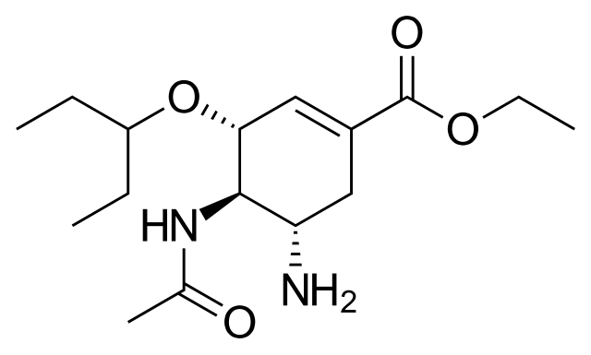
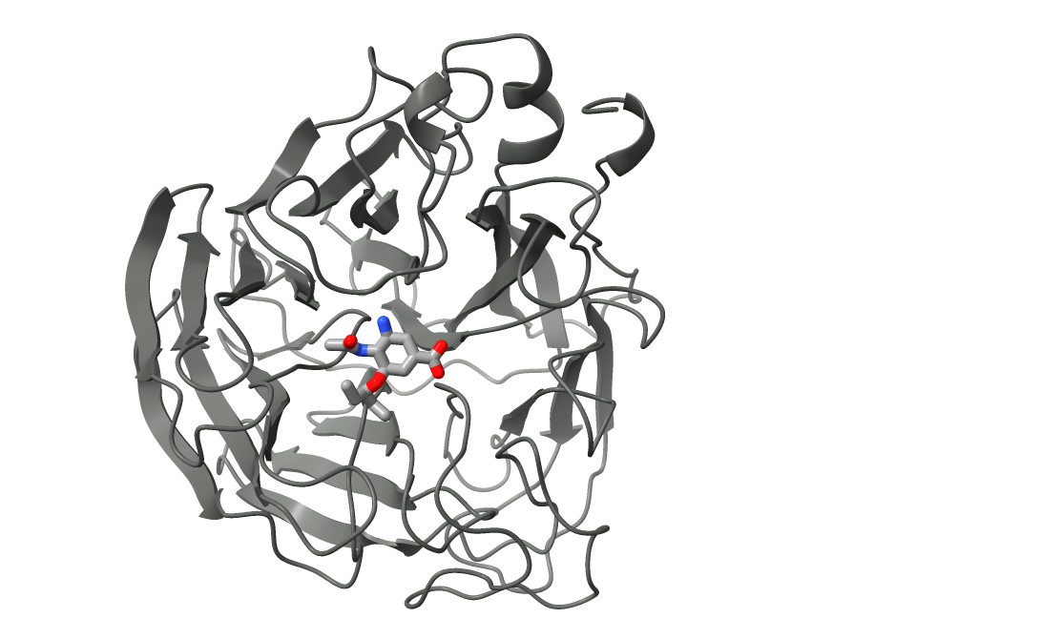
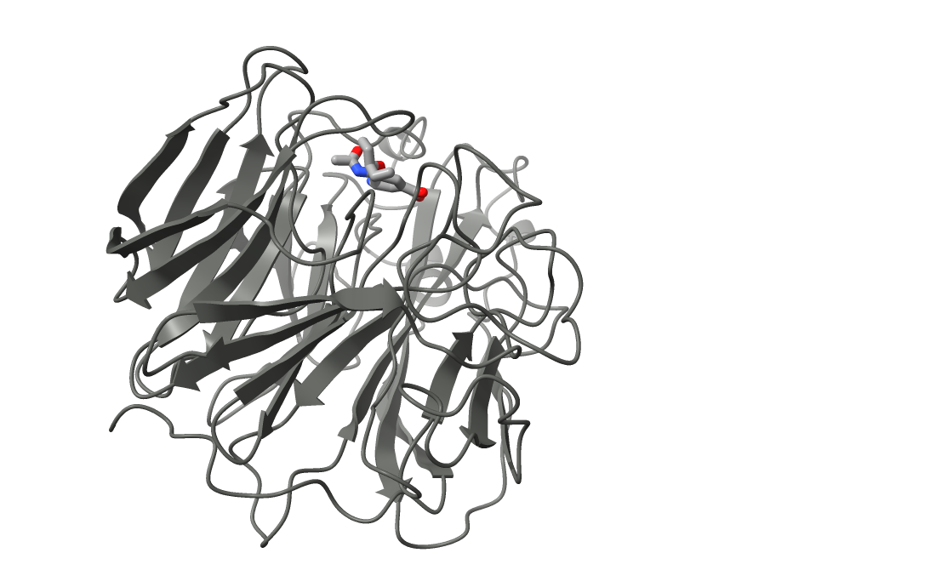
Today’s Tutorial
Tamiflu (Oseltamivir)
Inhibitor of neuraminidase for treatment of influenza. Binds non-covalently to active site of enzyme and blocks activity/binding.

Slide 20
Want More?
Registration Just Opened -- Vanderbilt RosettaWorkshop:
https://meilerlab.org/rosetta-workshop-spring-2025/rosetta-workshop-registration/
HPC Cluster-Based Tutorials On:
1) RFDiffusion
2) Protein design in Rosetta (with ProteinMPNN integration)
3) Protein-Protein Docking
4) Ligand Docking
5) Enzyme design with ML (RFDiffusion-AA & LigandMPNN)
6) Peptide design with Rosetta (with noncanonical amino acids)

Slide 21
References
Methodology
Fu D., Meiler. J. RosettaLigandEnsemble: A Small-Molecule Ensemble-Driven Docking Approach. ACS Omega, 3(4): 3655-3664 (2018).
DeLuca, S., Khar, K. & Meiler, J. Fully Flexible Docking of Medium Sized Ligand Libraries with RosettaLigand. PLoS One 10, e0132508 (2015).
S. Combs et al., Small-molecule ligand docking into comparative models with Rosetta, Nature Protocols 8, 1277–1298 (2013).
G. Lemmon, J. Meiler, R. Baron, Ed. RosettaLigand docking with flexible XML protocols, Methods in Mol Biol 819, 143–155 (2012).
I. W. Davis, D. Baker, RosettaLigand docking with full ligand and receptor flexibility., Journal of molecular biology 385, 381–92 (2009).
K.W. Kaufmann et al., Small Molecule Rotamers Enable Simultaneous Optimization of Small Molecule and Protein Degrees of Freedom in ROSETTALIGAND Docking, German Conference on Bioinformatics, pp. 148–157 (2008)
J. Meiler, D. Baker, ROSETTALIGAND : Protein – Small Molecule Docking with Full Side-Chain Flexibility, Proteins 548, 538–548 (2006).
Applications
K. J. Gregory et al., Probing the metabotropic glutamate receptor 5 (mGlu5) positive allosteric modulator (PAM) binding pocket: discovery of point mutations that engender a “molecular switch” in PAM pharmacology., Molecular pharmacology 83, 991–1006 (2013).
B. Allison et al., Computational design of protein-small molecule interfaces., Journal of structural biology (2013), doi:10.1016/j.jsb.2013.08.003.
G. Lemmon, J. Meiler, Towards ligand docking including explicit interface water molecules., PloS one 8, e67536 (2013).
G. Lemmon, K. Kaufmann, J. Meiler, Prediction of HIV-1 protease/inhibitor affinity using RosettaLigand., Chemical biology & drug design 79, 888–96 (2012).
K. W. Kaufmann, J. Meiler, Using RosettaLigand for small molecule docking into comparative models., PloS one 7 (2012), doi:10.1371/journal.pone.0050769.
K. W. Kaufmann et al., Structural determinants of species-selective substrate recognition in human and Drosophila serotonin transporters revealed through computational docking studies., Proteins 74, 630–42 (2009).
Regan, J. et al. Structure-activity relationships of the p38alpha MAP Kinase Inhibitor 1-(5-tert-Butyl-2-p-tolyl-2H-pyrazol-3-yl)-3-[4-(2-morpholin-4-yl-ethoxy)naphthalen-1-yl]urea (BIRB 796). Journal of Medicinal Chemistry 46, 4676-4686 (2003).
https://www.bindingdb.org/validation_sets/index.jsp

